Slide 1

Hakuna Moscato, A deep dive into the wonderful World of Wine!
Cameron Farquhar
Yuri Groza
Beth Myers
Jimmy White
Kurt Dietrich
Jared Nieves

Slide 2
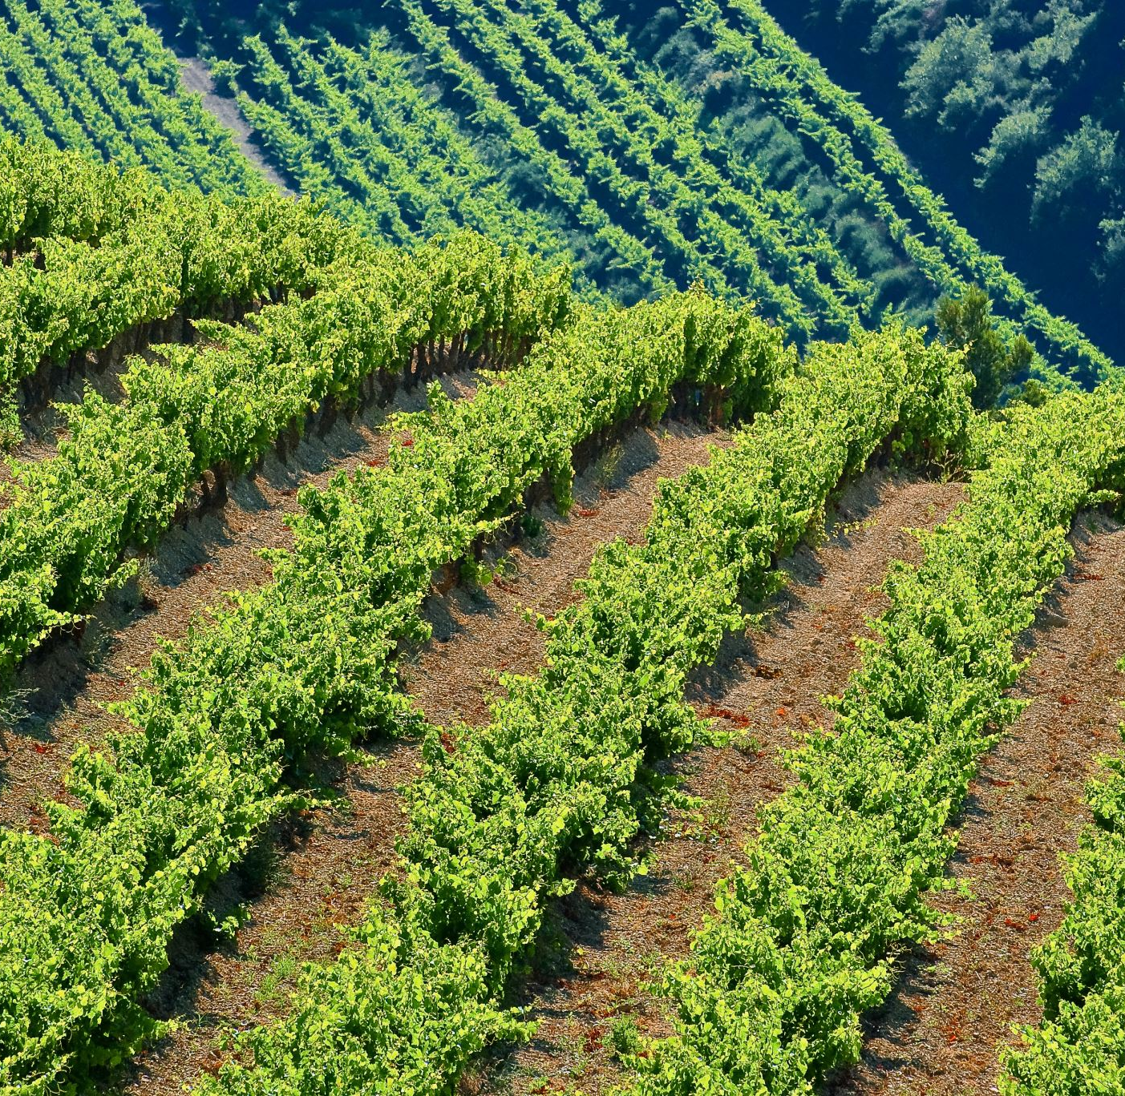
What factors contribute to a wine’s rating?
Age – How much time a wine has had to mature?
Color – Do red wines receive higher reviews than white? Or vice versa?
Flavor – Which words are most commonly associated with highly rated wines?
Price – Is price a factor in wine quality? Is there a point of diminishing returns?
Region – Do certain countries or regions make better wine than others?

Slide 3
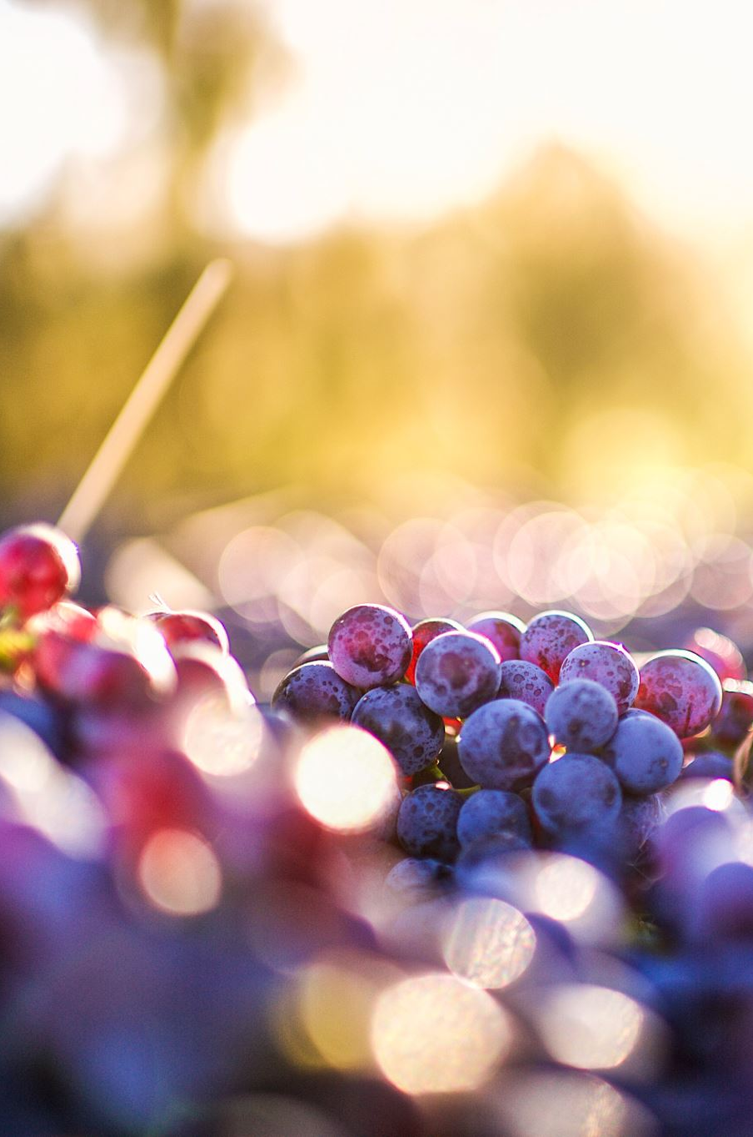
Harvesting the data
Two primary datasets were hand selected for their top-quality traits and reliable insights
Global Wine Score API. This dataset contains attributes such as score, vintage, en primeur status, region and confidence rating.
Wine Magazine CSV. Entailing information like written descriptions, price and winery.

Slide 4
Crushing the numbers
The Wine magazine dataset consisted of two files, the first with 150k rows and the second with 130k.
Through the joining, transformation and cleaning process, unnecessary columns and rows were removed.
We were hard pressed to use over 280k rows so the dropping null values was a relief.

Slide 5
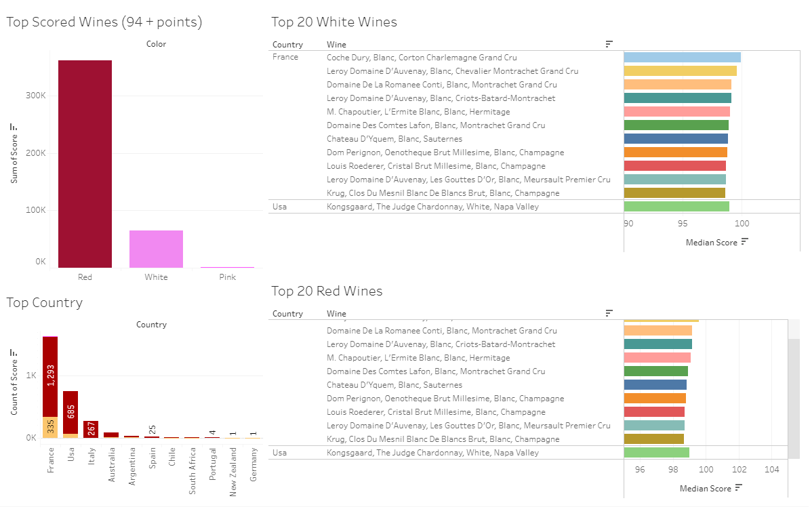
The first taste
Credit: Beth Myers
Our teammates Beth Myers and Kurt Dietrich used Tableau to uncover initial findings.

Slide 6
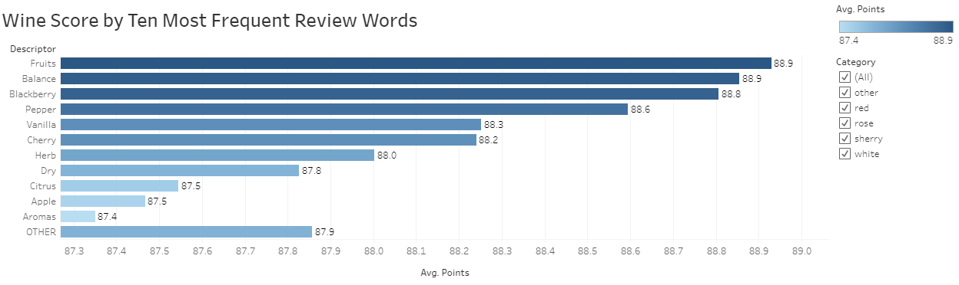
Words and their relation to rating
Most used words:
Fruits
Balance
Credit: Kurt Dietrich

Slide 7
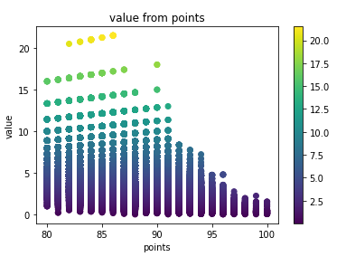
The Sweet spot
Credit: Yuri Groza
Value is determined by dividing points by price
After 90 points, a severe rate of diminishing returns occurs
The wine in the “sweet spot” is the California Syrah Fusée which sells for $5

Slide 8
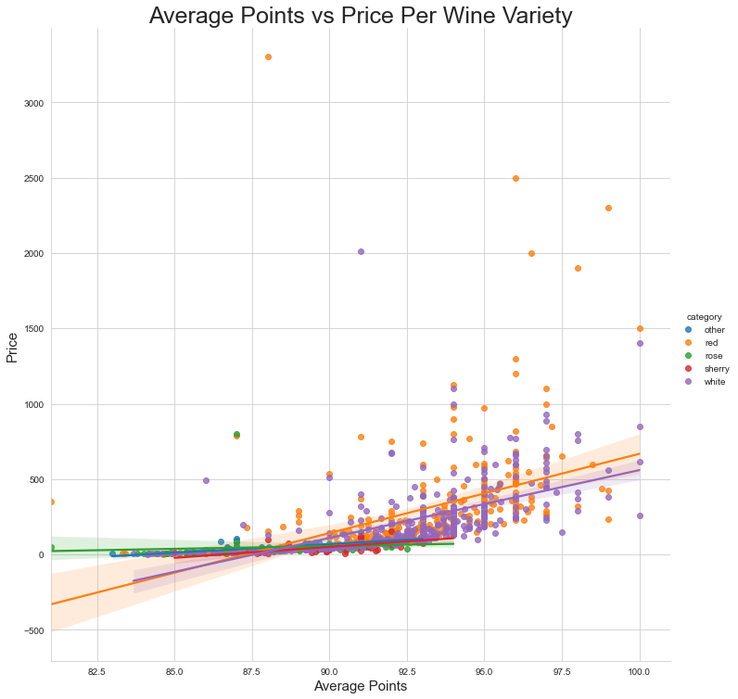
The Bitter Truth
Correlation between average wine score and price per wine by category
Higher priced wines do not necessarily receive a higher rating.
The correlation coefficient for all categories combined is .46
Credit: Jared Nieves

Slide 9
Clarification with Machine Learning
We set out to discover if a wine’s En Primeur status effects its rating.
This is important because En Primeur refers to the process in which investors can purchase futures of a specific batch before it hits the market, often before the wine even begins the fermentation process.
Only two regions offer wine to be sold En Primeur; Bordeaux and Sud Ouest

Slide 10
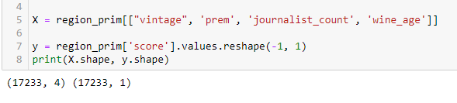
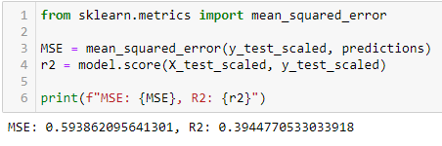
Bottling the results
Using Scikit-Learn’s Univariate Linear Regression, we found a weak R score between En Primeur and score, so we tried another Multivariate Linear Regression (MLR).
Testing En Primeur, Journalist Count, Vintage and Wine Age against Score, we discovered an R score of ~.39 and Mean Squared Error of ~.59.
Though relationship was still not as strong as we hoped for, the higher score derived by using MLR can be attributed to the fact that as more values enter a model, the stronger the prediction will typically become.

Slide 11
From the cellar to the table
The data harvested from both sources was deployed to an interactive Heroku app and visualized using Javascript libraries Charts.js and Plotly.
https://hakuna-moscato.herokuapp.com

